Slide 1
Multi Channel FM Transponder (MCFMT)
Andrew Robinson
Joseph DiVerdi

Slide 2
High Level Needs (from Jonathan’s email)
Start with:
Single signal path
VHF voice signal transponded as a UHF voice signal
Could be a SDR w/digital radio chip
Could be analog
Fit onto a CubeSat board
Ideally 2” x 2” area
Radiation tolerant
Avoid CMOS

Slide 3
Goal
Per chat with Heimir (at least my interpretation):
Multiple repeaters on a single satellite
I.e., multiple up frequencies with multiple down frequencies
Mix of U/V and V/U (?)
Are there other goals? Added capabilities? Lower SWaP-C?

Slide 4
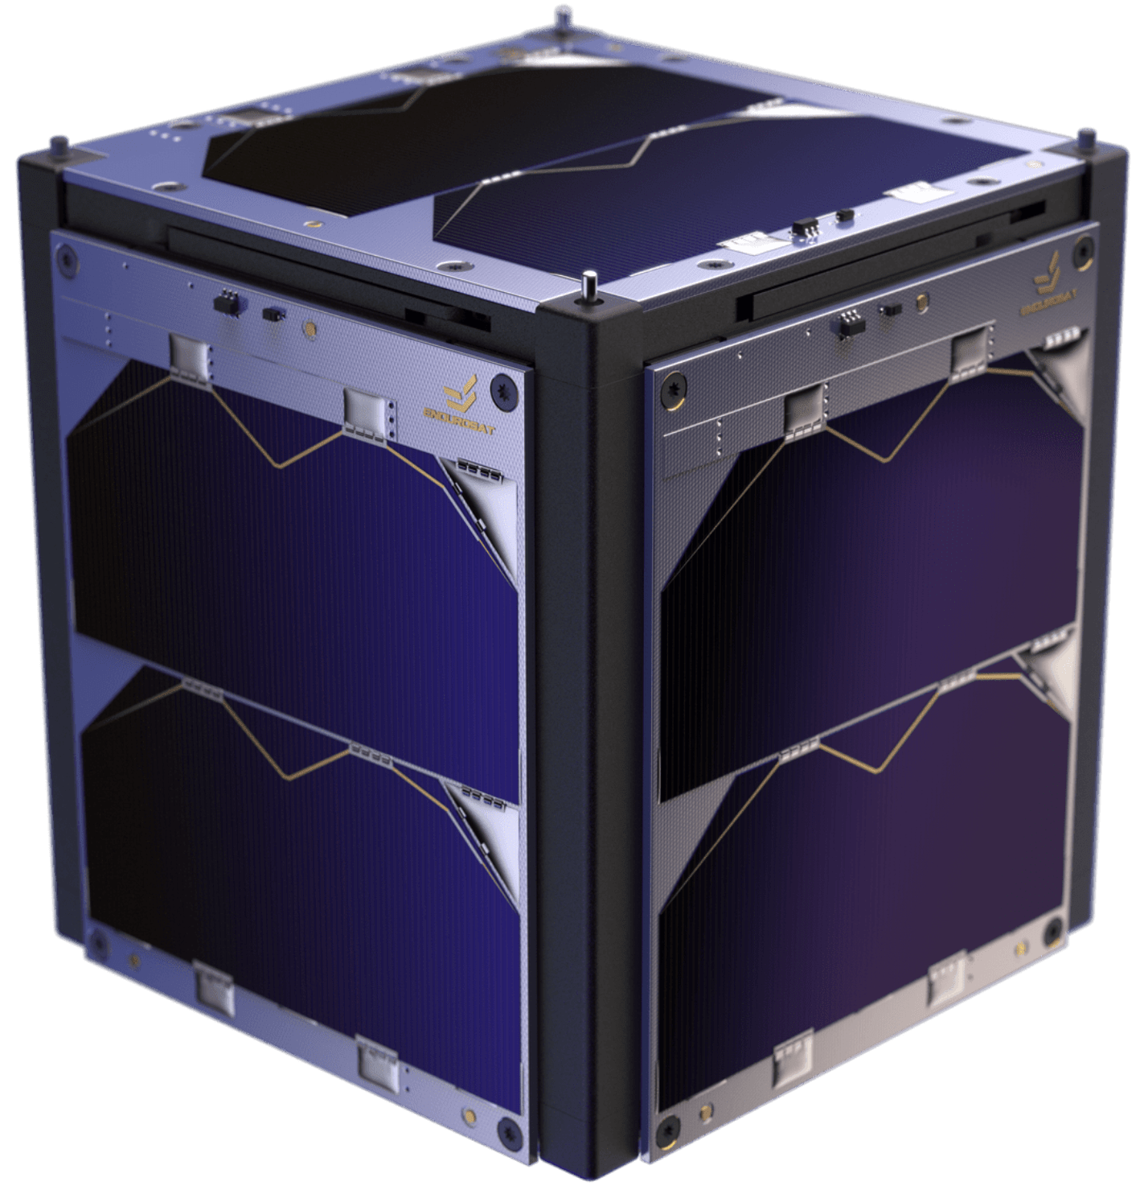




OV-1
Multiple (how many?) transponders on a single satellite
Up in VHF
Down in UHF
f_{UHF,N}
f_{UHF,1}
f_{UHF,2}
f_{VHF,N}
f_{VHF,1}
f_{VHF,2}

Slide 5
Tasks
Survey of open-source designs

Slide 6
High-Level Questions
# | Question | Response
1 | Are there any desired additional capabilities that we can enhance with a digital design or a SDR design?
2
3
4
5
6
7
8

Slide 7
Assumptions

Slide 8
Requirements(-ish)

Slide 9
Architecture

Slide 10
Multi Channel FM Transponder
Power
Commands
Bus
Tx Signals
Apertures
TLM
Rx Signals
Will the Bus have a comm system for TLM D/L or will the MCFMT be used?

Slide 11
Multi Channel FM Transponder
To Components
Processor
DC/DC
Digital Up-converter
DAC
Tx Front End
SSPA
Power
Tx
Signals
Commands
Digital Down-converter
ADC
Rx Front End
TLM
Rx
Signals
Reference signal: needed? (probably) → internal or external?

Slide 12
Receive Front End
Functions → Form:
Amplify incoming RF signals → LNA
Convert to an IF signal → Mixer and a LO
Filter IF signal (i.e., image filtering if needed?) → Filter
Notes/Questions/Observations:
Need a Front End for each signal?
Can this be “tuneable?” How do COTS SDRs cover such a wide range (e.g., 50 MHz to 3 GHz)?

Slide 13
Analog-to-Digital Converter (ADC)
Functions → Form:
Convert the IF signal input to a digital output → ADC (?)
Notes/Questions/Observations:
Need to figure out the drivers for this, e.g., resolution needed, etc.

Slide 14
Digital Downconverter
Functions → Form:
Take the digital IF signal and convert it to a digital baseband signal
Notes/Questions/Observations:

Slide 15
Processor
Functions → Form:
Demodulate and modulate the signal? Or is this just a bent pipe function?
Collect TLM, status, TBD from the pieces of the MCFMT
Process incoming commands from the Bus
Notes/Questions/Observations:

Slide 16
Digital Upconverter
Functions → Form:
Notes/Questions/Observations:

Slide 17
Digital-to-Analog Converter (DAC)
Functions → Form:
Convert the digital IF signal to an analog IF signal
Notes/Questions/Observations:

Slide 18
Transmit Front End
Functions → Form:
Convert the analog IF signal to the RF signal
Notes/Questions/Observations:

Slide 19
Solid State Power Amplifier (SSPA)
Functions → Form:
Amplify the RF signal
Notes/Questions/Observations:
What power is required to close the link?
Frequency, aperture, altitude dependent?

Slide 20
Design-y Questions
# | Question | Response
1 | What TLM is typically collected?
2 | How many signals?
3 | What is a good power draw to shoot for?
4 | Are reference signals (e.g., PPS, 50 MHz) available from the bus or should they be accounted for on the MCFMT?
5
6
7
8

Slide 21
Assumptions
# | Title | Assumption
1 | Input Power | A single source of power will be received from the bus Conversion and distribution of power is a function of the MCFMT
2
3
4
5
6
7
8

Slide 22
Acronyms
Acronym | Definition
ADC | Analog to Digital Conversion
COTS | Commercial Off The Shelf
D/L | Downlink
DAC | Digital to Analog Conversion
DC | Direct Current
FM | Frequency Modulation
IF | Intermediate Frequency
LNA | Low Noise Amplifier
LO | Local Oscillator
MCFMT | Multi-Channel FM Transponder
RF | Radio Frequency
Rx | Receive
SDR | Software Defined Radio
SSPA | Solid State Power Amplifier
TLM | Telemetry
Tx | Transmit
U/L | Uplink

Slide 23
Backup

Slide 24
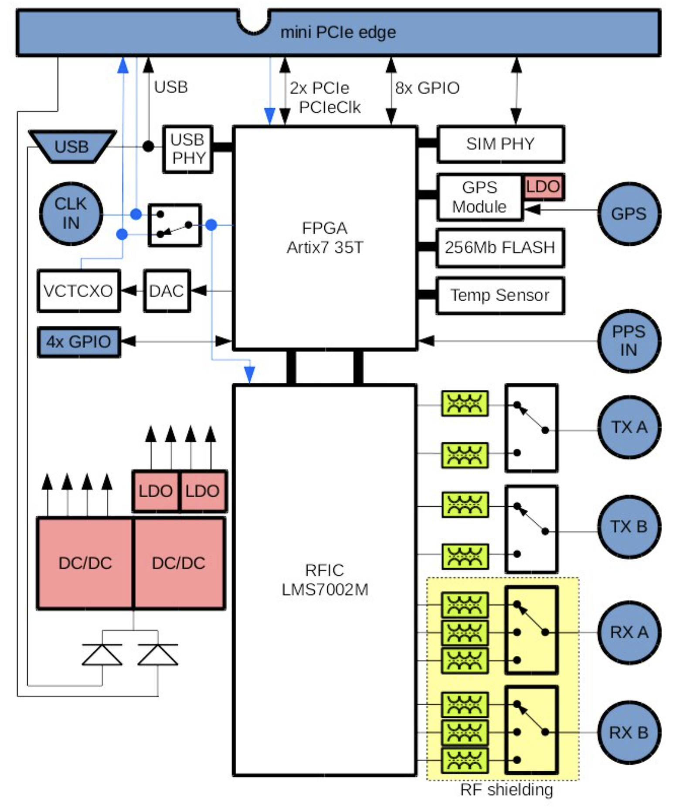
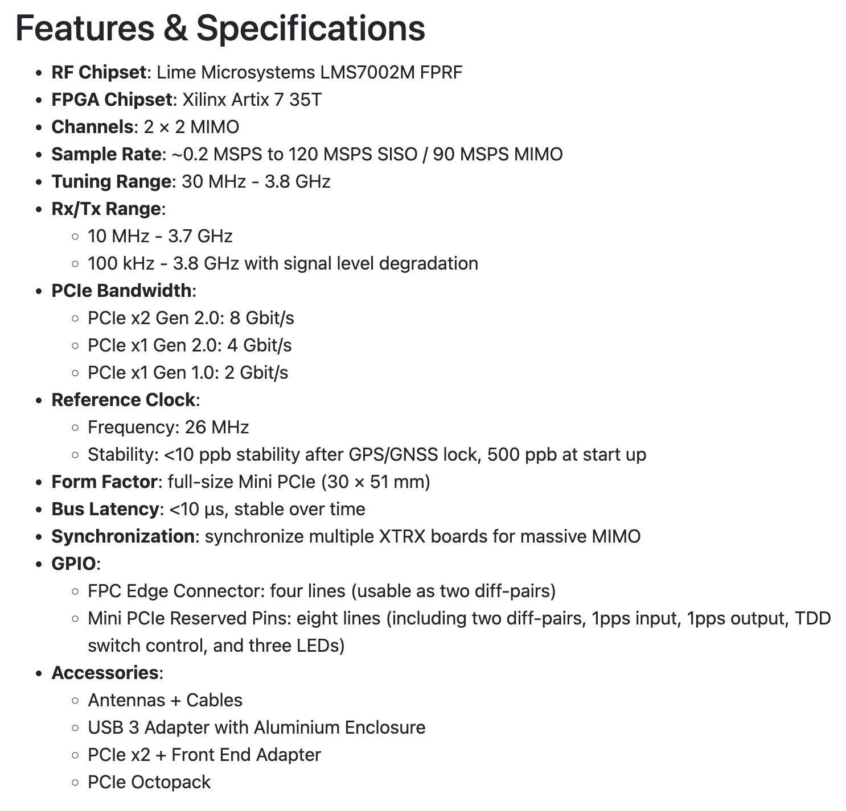
SDR
Fairwaves
XTRX
Source: https://www.crowdsupply.com/fairwaves/xtrx

Slide 25
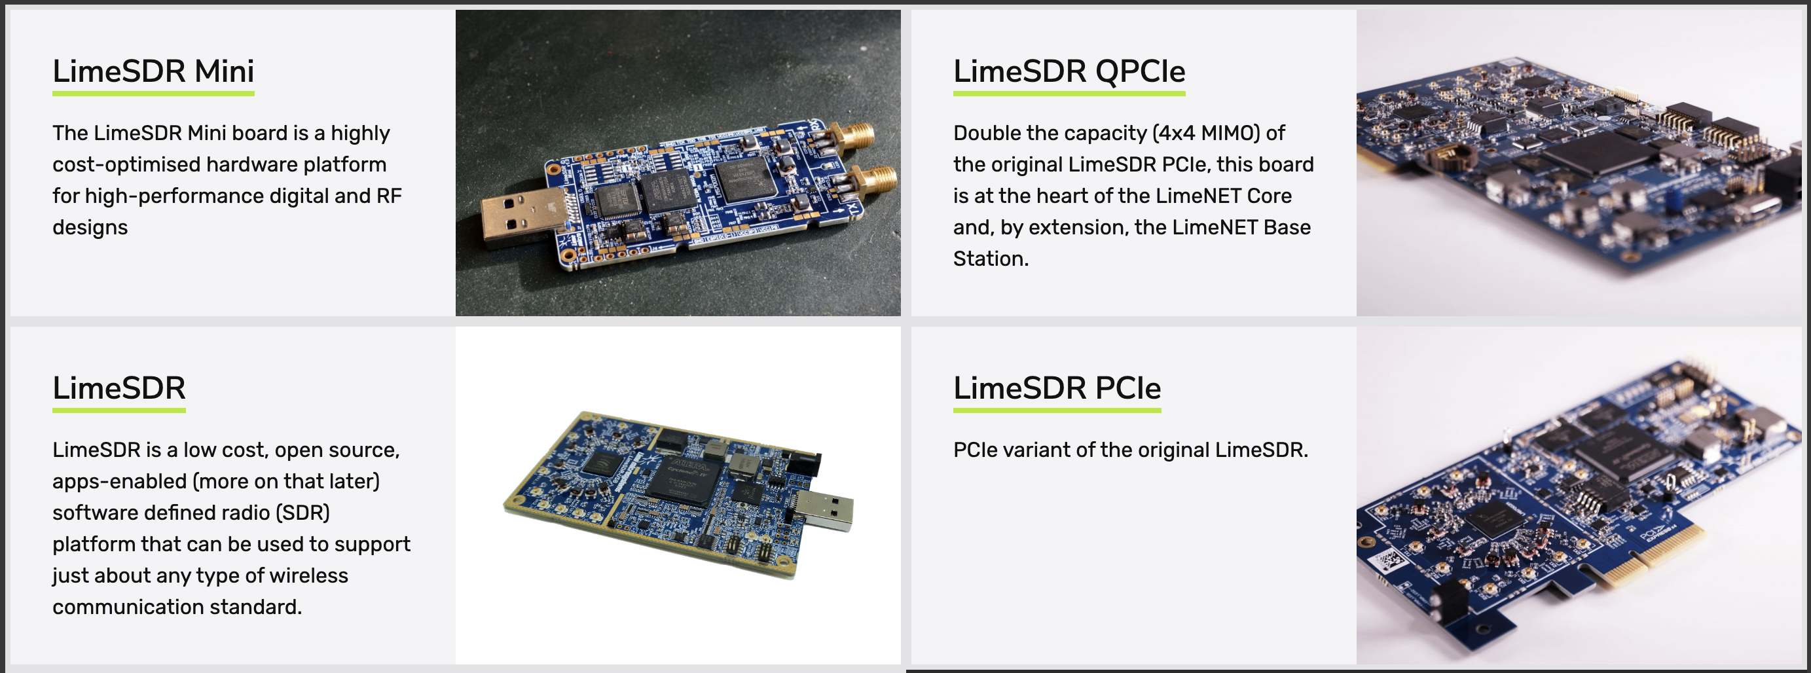
SDR
Lime Microsystems took over the XTRX (?)
Additional Options:
Source: https://limemicro.com/products/boards/

Slide 26
Repeater Basics

